Slide 1
Attitudes and Values

Slide 2
Values
Values are a fundamental determinant of behavior:
Values are abstract ideals that guide our thinking and behavior across all situations
There are two types of values:
Instrumental values define the behaviors that will lead to desired outcomes
LECTURE 2: Basics ∙ Attitudes ∙ Job Satisfaction

Slide 3
Values
Values are shaped by a combination of nature (e.g., genetics) and nurture (e.g., upbringing, experiences), making them unique from each
We are consciously aware of our values, and they can often differ from other characteristics we have, such as our personalities, skills, or appearance
LECTURE 2: Basics ∙ Attitudes ∙ Job Satisfaction

Slide 4
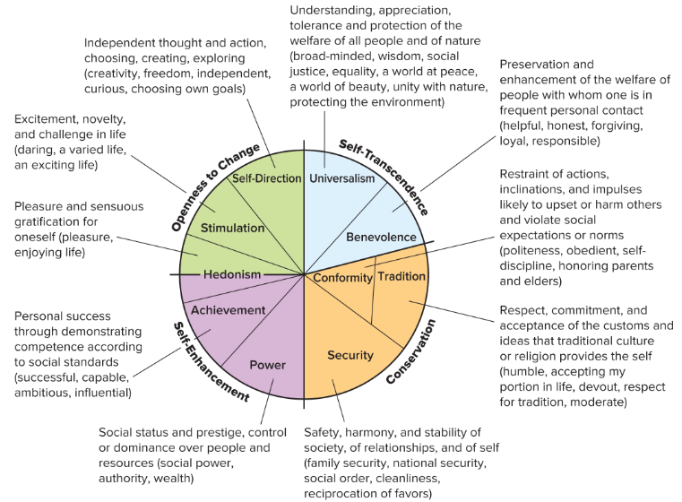
LECTURE 2: Basics ∙ Attitudes ∙ Job Satisfaction

Slide 5
Values
Many organizations create strong situations, in which employee behavior is modulated to meet external standards (e.g., rules, policies, norms, etc.) rather than follow internal ones, like values.
(Mischel, 1977; Weiss & Adler, 1984; Meyer, Dalal, & Hermida, 2010)
Clear and consistent job requirements that constrain personal discretion, and have consequences if violated, make a situation strong
LECTURE 2: Basics ∙ Attitudes ∙ Job Satisfaction

Slide 6
Values
When the organization creates situations that supply opportunities for employees to fulfill their values, workers fit better and are more satisfied and committed, and exhibit better well-being
(Choi, 2004; Edwards, 1992; Kristoff-Brown, Zimmerman, & Johnson, 2005)
Lack of supply-value fit doesn’t affect job performance….. at first
LECTURE 2: Basics ∙ Attitudes ∙ Job Satisfaction

Slide 7
Values
Lack of value fulfillment creates suboptimal behavior patterns that over time…
LECTURE 2: Basics ∙ Attitudes ∙ Job Satisfaction

Slide 8
Values
There are three general approaches:
Provide opportunities to fulfill values
Find people’s with matching values
Develop new values in our workers
Much of this begins when we create positive attitudes towards aspects of work
LECTURE 2: Basics ∙ Attitudes ∙ Job Satisfaction

Slide 9
Attitudes
What is an attitude?
A psychological tendency expressed by evaluating something with a degree of favor or disfavor
In the workplace, attitudes are formed about many different things ranging from one’s supervisor or boss, to the quality of one’s work environment (e.g., parking, lighting, noise, etc.)
LECTURE 2: Basics ∙ Attitudes ∙ Job Satisfaction

Slide 10
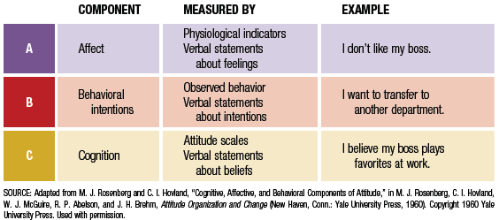
Attitudes
LECTURE 2: Basics ∙ Attitudes ∙ Job Satisfaction
Notes:
3

Slide 11
Attitude-to-Behavior Linkage
People desire to maintain consistency between their attitudes and behaviors
Cognitive dissonance is:
A state of tension that is produced when an individual experiences conflict between attitudes and behavior
Dissonance will be tolerated based on how important the attitude versus the behavior is to a person, and how much that person believes s/he can influence either
LECTURE 2: Basics ∙ Attitudes ∙ Job Satisfaction
Notes:
4

Slide 12
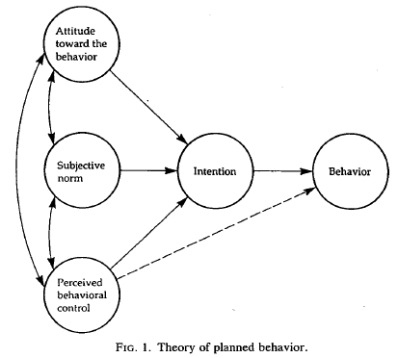
Attitude-to-Behavior Linkage
Attitudes are formed by one or more of three factors affecting beliefs (cognitive) and feelings (affect) towards an attitude object:
Personality traits
Direct experience
Social learning about the object
(Ajzen, 1991; Ajzen & Fishbein, 1977)
LECTURE 2: Basics ∙ Attitudes ∙ Job Satisfaction

Slide 13
Job Satisfaction
One of the most common, influential, and most studied attitudes in the workplace is job satisfaction
Job satisfaction is a positive emotional state resulting from one’s appraisal or evaluation of his or her job, and the parts of that job, and has ramifications for many types of employee behavior
LECTURE 2: Basics ∙ Attitudes ∙ Job Satisfaction

Slide 14
Job Satisfaction: Causes
Prior job satisfaction predicts present job satisfaction, however the effect is stronger for intrinsic satisfaction versus extrinsic satisfaction (Arvey, Segal, Bouchard, & Abraham, 1989; Staw & Ross, 1985)
Positive and Negative Affectivity are among the best predictors of satisfaction, they explain 55% of the genetic variance in satisfaction while Big 5 only explains 23% (Connolly & Viswesvaran, 2000; Ilies & Judge, 2003)
LECTURE 2: Basics ∙ Attitudes ∙ Job Satisfaction

Slide 15
Job Satisfaction: Causes
Three extrinsic (non-trait or personality) factors typically affect job satisfaction:
Work characteristics: Certain jobs (e.g., complex, challenging, autonomous) are more satisfying than others
Pay/benefits: High and equitable rewards are more satisfying
LECTURE 2: Basics ∙ Attitudes ∙ Job Satisfaction

Slide 16
Job Satisfaction: Consequences
Meta-analytic evidence consistently finds that job satisfaction has a .30 or lower correlation with job performance (which is small-to-moderate) (Iaffaldano & Muchinsky, 1985; Judge, Thoreson, Bono, & Patton, 2001; Petty, McGee, & Cavender, 1984)
The link between job satisfaction and job performance is stronger, however, when:
For employees with complex jobs
When valued rewards are contingent on performance, or rewards are high
LECTURE 2: Basics ∙ Attitudes ∙ Job Satisfaction

Slide 17
Job Satisfaction: Consequences
Job satisfaction only moderately (negatively) predicts turnover and absenteeism, but strongly correlates (negatively) with intention to turnover and withdrawal cognitions
(Scott & Taylor, 1985; Tett & Meyer, 1993)
Job satisfaction (especially the cognitive component) strongly positively predicts organizational citizenship behaviors (OCBs), and has a strong positive relationship with organizational commitment (LePine, Erez, & Van Dyne, 2002; Meyer, Stanley, Herscovitch, & Topolnytsky, 2002; Moorman, 1993; Williams & Anderson, 1991)
LECTURE 2: Basics ∙ Attitudes ∙ Job Satisfaction

Slide 18
Job Satisfaction: Consequences
Organizational commitment is the strength of a person’s identification with their organization and their desire to stay in that organization; there are three facets of organizational commitment:
Affective commitment: A desire to stay due to emotional connection with the organization
Continuance commitment: Too costly to leave, need to stay for resource purposes
LECTURE 2: Basics ∙ Attitudes ∙ Job Satisfaction

Slide 19
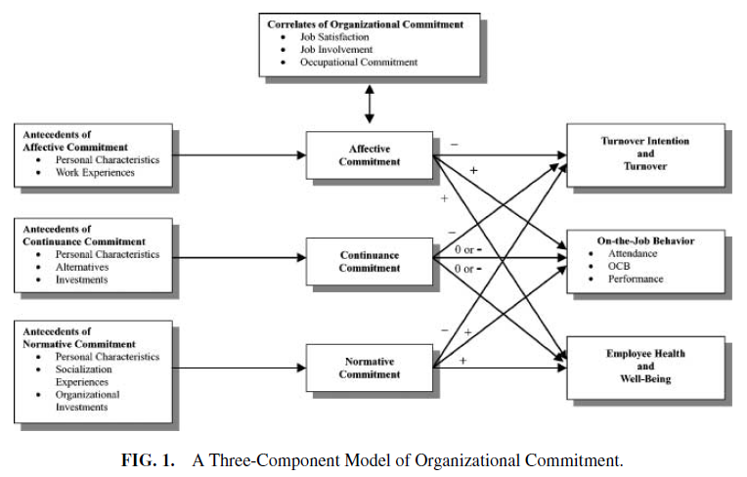
Job Satisfaction: Consequences
Meyer, Stanley, Herscovitch, & Topolnytsky (2002), and others
LECTURE 2: Basics ∙ Attitudes ∙ Job Satisfaction

Slide 20
Job Satisfaction: Consequences
Satisfied and committed individuals are more likely to contribute to their organization
Organizational Citizenship Behaviors are prosocial helping behavior that support the psychological and social environment in which task performance occurs
What are some of the causes of OCB?
LECTURE 2: Basics ∙ Attitudes ∙ Job Satisfaction

Slide 21
Attitude Change
There are three factors that influence the success of persuasion and attitude change:
Source: Expertise, trustworthiness, attractiveness
Target: Self-esteem, attitude strength, mood
Message: Acknowledge all sides of attitude object, threat level, emotional tone
LECTURE 2: Basics ∙ Attitudes ∙ Job Satisfaction

Slide 22
Attitude Change
The Elaboration Likelihood Model explains two ways that attitude change may occur:
Central route | Peripheral route
Target pays close attention to message | Target pays little attention to message (e.g., distracted, does not value message)
Message processing is: Careful and conscious | Message processing is: Automatic and not careful
Attitude change determined by: Quality of argument | Attitude change determined by: Source characteristics (e.g., expertise) Non-substantial aspects of argument (e.g., the mere presence of data, quantity of facts, etc.)
LECTURE 2: Basics ∙ Attitudes ∙ Job Satisfaction

